Slide 1
Product Launch
Hosted by Product Tank Pune

Slide 2
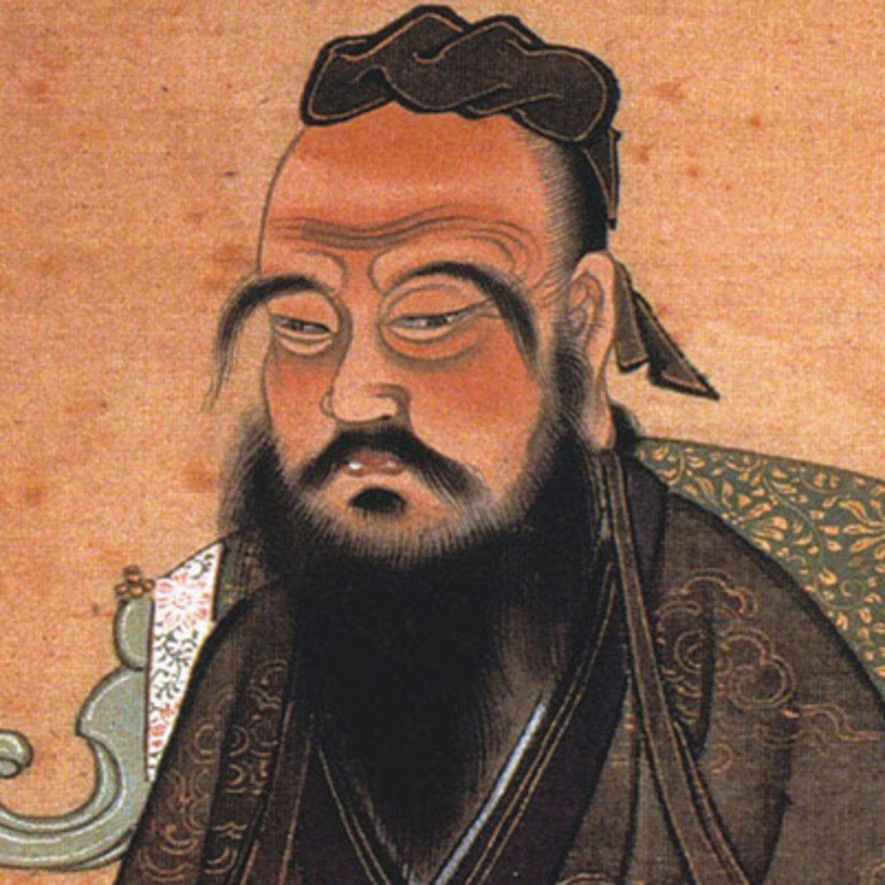
“How does one find a wife? Without a matchmaker one does not.”
Confucius

Slide 3
How do you maximize your launch success & bring order in the chaos?
Strategic Decisions
Process?
Product Success?
Launching a product requires collaboration & coordination with multiple stakeholders at all times?
Support?
Positioning?

Slide 4

Take a screenshot now
But by having a framework which you start working on as soon as the development work begins
📈
Metrics
Acquisition
Commitment
Post-Launch
🎙️
Channel
Online
Offline
Big Bang
🚀
Push
Pull
Strategy
🐣
Bottom to top
Market
Demand
Supply
Soft-Launch
🔓
Product
Features
Benefits
Monetization
Pre-Launch
🔍
Problem
Defining the Problem
Notes:
Path needs to be chosen.

Slide 5
This generic framework can be moulded for different type of product launches
Type of Launch
Product Segment
I am launching the first product in my company
I am launching a consecutive product in my company
I am launching some new features in my company
I want to launch a B2C product
I want to launch a B2B product
I want to launch a B2B2C product

Slide 6




Before we begin some FAQs
Time, money, stakeholder independent framework
Is this set in stone?
Can I remove/add things in the framework?
When should I start with it?
Does it cover marketing?
No, it will evolve as the market evolves, few years ago, online did not exist and so didn’t a prominent B2B2C marketplace
Yes, for specific segments, some of the elements of the framework don’t remain relevant and we will cover that over the course of the presentation
From Day 1 when the company has decided to venture in the development.
Product managers need to orchestrate
Does not get into details but covers the framework so that the specifics are never missed

Slide 7

So how do I start?
Launch-Day
Right from the bottom by working on the foundation

Slide 8
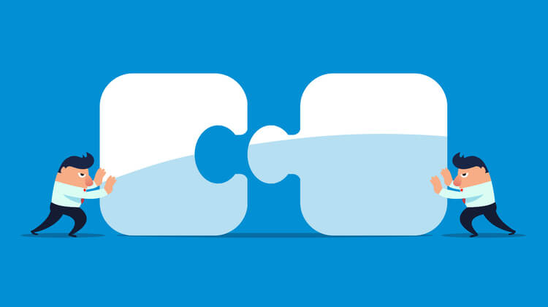
Pre-Launch Goal
“Get those pieces together”
The Why
Who
What’s

Slide 9
We start from the very beginning - The Pre-Launch
📈
Acquisition
Commitment
Metrics
Post-Launch
🎙️
Channel
Online
Offline
Big Bang
🚀
Push
Pull
Strategy
🐣
Bottom to up
Market
Demand
Supply
Soft-Launch
🔓
Product
Features
Benefits
Monetization
Pre-Launch
🔍
Problem
Defining the Problem
Notes:
Path needs to be chosen.

Slide 10
Defining the Problem
B2B2C Common Problems
Fragmented Resources
Inefficient Markets
Demand & Supply Gap
“THIS is your anchor statement for any elevator pitch”
Cover inefficiencies which have led to loss of time, money & created a gap in the market

Slide 11

Example: PayTM 2010
Consumer #1
Consumer #2
Consumer #3
Consumer #4
Fragmented recharge space
Recharging was exhaustive and inefficient
Information about the right recharge was left to your favorite dukaanwala
Dukaanwala end up spending enormous time only doing recharges all day leaving lot of other customers a dismay
Recharge
Shop #1
Shop #2
Shop #3
Shop #4
Airtel
Vodafone
BPL
MTNL
Recharge #1
Recharge #2
Recharge #1
Recharge #2
Recharge #1
Recharge #2
Recharge #1
Recharge #2

Slide 12
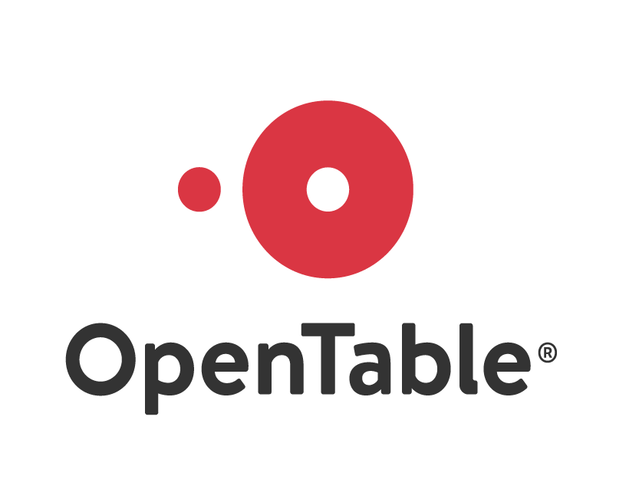
Example: OpenTable - 1998
Consumer #1
Consumer #2
Consumer #3
Consumer #4
Restaurant industry was fragmented
Restaurant dining booking were inefficient
There were times when there was either excess demand in a restaurant and not enough to supply and times when there was no demand and there was excess supply
Restaurants lose lot of business because of unoccupied tables on fast-moving day
Booking Tables
Restaurant #1
Restaurant #2
Restaurant #3
Restaurant #4
Table #1
Table #2
Table #1
Table #2
Table #1
Table #2
Table #1
Table #2

Slide 13
Product
when you design your launch strategy how do you want to position it?
Features
Benefits
Monetization
List down all the features of the product
Every small part of the product should be covered
List down the benefits of using the product by having metrics which
Save Time
Save Cost
Increase Efficiency
Increase Revenue
Increase Experience
List down possible monetization strategies for the usage of the product
Advertisement
Transaction Fee/Platform Fee
Subscription Fee
Setup Fee

Slide 14
Product
 | Features | Benefits | Monetization
B2C (Consumers) | Availability of all the recharges for every operator in India Availability of recharge options for both mobile and DTH Recharge right from your phone | Recharge instantly credited into your account For every recharge done on your phone you save 20 mins of your day - (time in queue in mobile shops and recharge queue) | -
B2B (Operators) | Integrated with operators to unbundle new products like SMSC, USSD gateways & call management systems | Increase revenue per customer by giving ease of recharge Get insights on customers with additional profile information | Product Banners & advertisement on the platform Convenience fee from the operators

Slide 15
Product
 | Features | Benefits | Monetization
B2C (Consumers) | See all the restaurants in your area See the available dining tables in the restaurant in the slot of your choice Book directly from your phone Accept booking right from your desktop Provide personalized offers to the customers | Find available tables by allowing diners to search for reservations by location, date, time and party size and view real-time table availability across a variety of restaurant Book instantly-confirmed reservations for free | -
B2B (Restaurants) | Table booking management for the restaurants to simplify booking experience | Increase in-dine booking per restaurant Boost guest services by providing personalization | Installation fee and rental Booking Fee

Slide 16
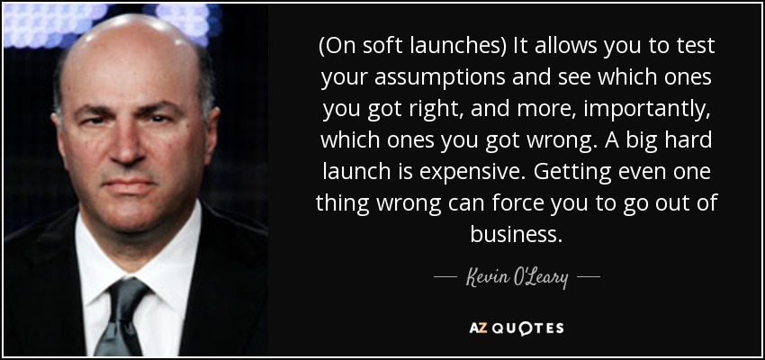
Soft-Launch Goal
“Test that piece out and find your place”

Slide 17
Next, do a soft-launch by going to a segment of the market
📈
Metrics
Acquisition
Commitment
Post-Launch
🎙️
Channel
Online
Offline
Big Bang
🚀
Push
Pull
Strategy
🐣
Bottom to up
Market
Demand
Supply
Soft-Launch
🔓
Product
Features
Benefits
Monetization
Pre-Launch
🔍
Problem
Defining the Problem
Notes:
Path needs to be chosen.

Slide 18
Market
at the time of launch where should you start or find your ANCHOR population
Demand
Supply
Define your target segment at the time of launch by
Size (Individuals, Small Business, Large Organization)
Geography (Metros, Tier-2, Tier-3)
Demographic Profile (Age, Gender, Employment)
Lifestyle
Define your target segment at the time of launch by
Size (Individuals, Small Business, Large Organization)
Geography (Metros, Tier-2, Tier-3)
Demographic Profile (Age, Gender, Employment)

Slide 19

Market
Demand
Supply
Partner with smaller lead generators for get customers
  Tier-2 to Tier-3 customers
  Income group of 20-40k
  Age 25-35
  Mobile First customer
  New to Credit Customer
Partner with 1 NBFC
  mid-size capital
Learn
  Technical Challenges
  Operational Challenges
  Business Challenges

Slide 20
Recap & Learnings
Identify the problems
List features, benefits, monetization
Soft-Launch to a smaller segment of the market
Identified the Product-Market Fit
Finalized the Positioning

Slide 21

Preparing for the Big Launch
B2B2C Common Problems
Fragmented Resources
Inefficient Markets
Demand & Supply Gap
“Once you have tested out, made amendments you push out your strategy”

Slide 22
Take a screenshot now
The big bang to pull in your customers to the platform
📈
Metrics
Acquisition
Commitment
Post-Launch
🎙️
Channel
Online
Offline
Big Bang
🚀
Push
Pull
Strategy
🐣
Bottom to up
Market
Demand
Supply
Soft-Launch
🔓
Product
Features
Benefits
Monetization
Pre-Launch
🔍
Problem
Defining the Problem
Notes:
Path needs to be chosen.

Slide 23
Strategy
What is the strategy you want to use to launch your product?
PUSH
PULL
Community communication
  Social Media, Forums
Pipeline Communication
  Ex: TV, Radio, Roadshow, Seminars
Partner with existing ecosystem
Seeding
Incentivize the marquee users
Single-sided strategy
Influential strategy
Limited seats strategy

Slide 24





Channel
Every launch comes with a budget and it is important that you utilize that to maximize your acquisition at the lowest cost possible
Online
Offline
Choose the channel you want to budget your strategy on
Social Media
  Facebook, Instagram, Twitter
Communities
  Product Hunt, Forums
Traditional Communication
  Email, SMS
Choose the channel you want to budget your strategy on
Offline Media
  TV, Radio
Networking Events
  Conferences, Exhibitions
Fleet on Street
  Roadshow

Slide 25
Strategy
PUSH
PULL
Community communication
  Utilized blogging network for pushing cashback offers to the users
  Utilize social media to attract users
Single-Sided Strategy -> Partnered with operators and build various solutions for them via One97 communications
Incentivize the marquee users -> Cashback & Coupons pulled users to the platform to complete their recharges
Source: http://www.cmlinks.com/pub/dp/dp40147.pdf

Slide 26
Strategy
PUSH
PULL
Community communication
  Utilized social media to attract users
  Utilized word-of-mouth within the community to inform users about the platform
Single-Sided Strategy -> Build restaurant solutions like inventory management and booking management services
Incentivize the marquee users -> Free booking converted into reward points attracted the user onto the platform
Source: https://www.sec.gov/Archives/edgar/data/1125914/000104746909000513/a2190140zs-1.htm

Slide 27
And ensure that you are able to track all of your effort
📈
Metrics
Acquisition
Commitment
Post-Launch
🎙️
Channel
Online
Offline
Big Bang
🚀
Push
Pull
Strategy
🐣
Bottom to up
Market
Demand
Supply
Soft-Launch
🔓
Product
Features
Benefits
Monetization
Pre-Launch
🔍
Problem
Defining the Problem
Notes:
Path needs to be chosen.

Slide 28

Post-Launch
B2B2C Common Problems
Fragmented Resources
Inefficient Markets
Demand & Supply Gap
“Keeping an extremely close watch to see how your product picks up, learn, improve and navigate to the right direction”

Slide 29
Metrics
To determine launch success, ensure you have all the right metrics in place
Acquisition
Commitment
%age of failure to convert
%age of negative feedback to total feedback
Acquisition
Commitment
Ensure you define what an acquisition is
Registration Metrics (Demand/Supply)
Unit Metrics for Cost (Acquisition like avg cost for first transaction)
*mobile OTP registration is not acquisition.
First transaction is non-monetary or monetary.
Key Metrics that you need to track for short & medium term until your definition of success is met
Conversion Metrics
Illiquidity Metrics or Quality Metrics
Value Creation Metrics or Experience Metrics
Volume Metrics
Acquisition
Commitment

Slide 30
Metrics
To determine launch success, ensure you have all the right metrics in place
Acquisition
Commitment
%age of failure to convert
%age of negative feedback to total feedback
Acquisition
Commitment
Total Installations in a time period
Avg Cost / Installation per day broken down by segment
Avg cost / first transaction broken down by segment
Avg recharge size / Customer per day broken down by segment
Avg cost / recharge per day (because you are giving cash backs)
Avg recharge failures / day
Incomplete transactions / day
Acquisition
Commitment

Slide 31
Metrics
To determine launch success, ensure you have all the right metrics in place
Acquisition
Commitment
%age of failure to convert
%age of negative feedback to total feedback
Acquisition
Commitment
Number of restaurant booking per day
Number of restaurants acquired in a given time period
Cost / restaurant booking in given time period
Distribution of restaurant booking per day
%age of restaurants with no booking / day
Customer Booking cancellations % / day
Restaurant Booking cancellations % / day
Incomplete bookings % / day
Acquisition
Commitment

Slide 32


Launch Preventive Measures
A huge topic in itself, we will only scratch the surface here
Legal & Governance
Consult
Competitors
Watch
Technology Failures
Test

Slide 33
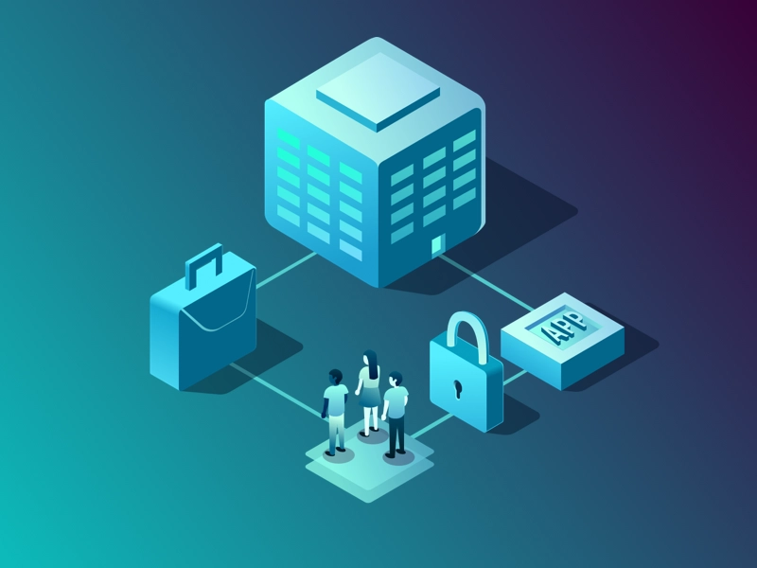
Legal & Governance
WIP
Be early to take legal guidance on your product
Consult at every stage of your lifecycle

Slide 34

Competitors
WIP
“No business is a zero-sum business”
Only track don’t worry
Identify differentiators
Find your space

Slide 35

Technology Failures
WIP
Soft-launch your product to a very very small set of users
Identify and fix before big launch to avoid disappointment

Slide 36

Essentials at the time of launch?
Track your metrics closely
Watch out for any nefarious activities
Watch out for negative feedbacks

Slide 37
Thank You!

Slide 38




Recommended Reads
Read more about
One97 IPO
http://www.cmlinks.com/pub/dp/dp40147.pdf
OpenTable IPO
https://www.sec.gov/Archives/edgar/data/1125914/000104746909000513/a2190140zs-1.htm
Platform Launch Strategy
Stratechery
https://knowledge.insead.edu/node/4834/pdf

